Slide 1

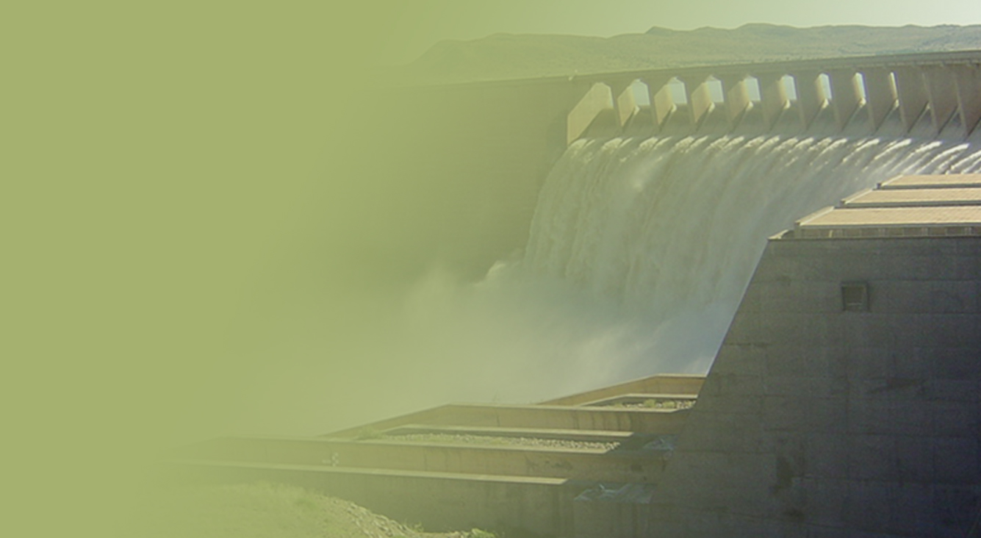
Support of the Water Reconciliation Strategy for the Algoa Water Supply System
ATSG Meeting
Aurecon
16 August 2017
PRESENTATION TITLE
Presented by:
Name Surname
Directorate
Date

Slide 2
8.2 Feasibility evaluation: Additional balancing storage in the LSRGWS

Slide 3
Selected Options for Investigation
Construction of a larger dam near the present Scheepersvlakte Dam site and integrate this dam with the existing gravity pipeline to the Nooitgedagt WTW.
Construct a large balancing dam on the right bank near the Nooitgedagt WTW.

Slide 4
Construction of a larger dam near the present Scheepersvlakte Dam site
The site falls on land being planned for development by the Scheepersvlakte 98 Citrus Development Trust.
The Trust agreed to co-operate with the DWS and possible future works, should the new dam option be pursued further.
The dam will be sized for the combined NMBM balancing capacity of 4 410 Mℓ (21 days balancing storage) plus the Developer’s required irrigation capacity.
Advantages | Disadvantages
Reduced risk of supply to NMBM Simplified operations for the LSRWUA Shared cost with Developer Simplified integration into existing system (close to ScD) | Shared with Developer = coordination needed Potential increase in quantum of algae Potential compensation for land Still reliant of existing pipeline = does not improve risk of failure

Slide 5
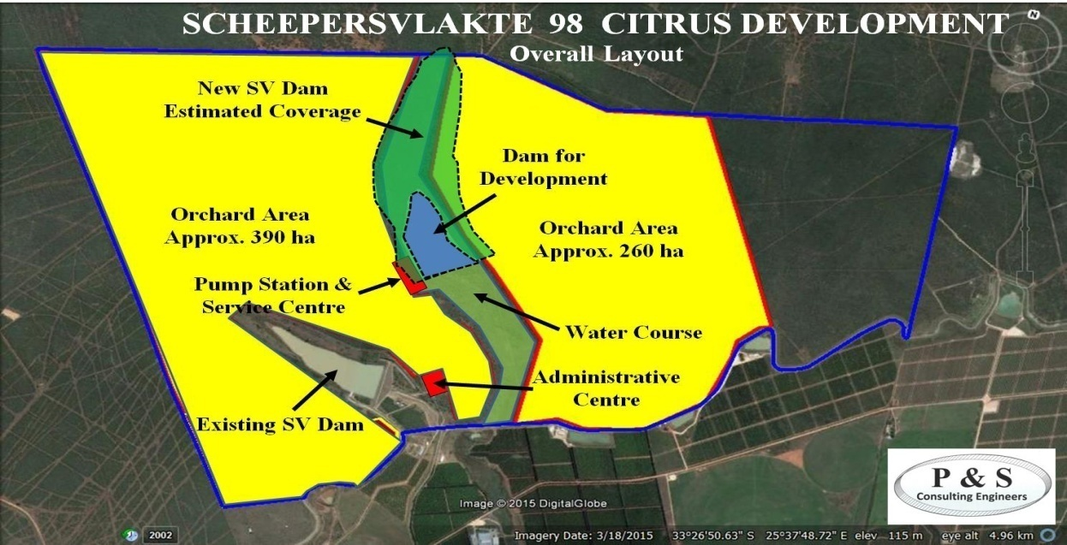
Construction of a larger dam near the present Scheepersvlakte Dam site

Slide 6
Construct a large balancing dam on the right bank near the Nooitgedagt WTW
The proposed dam would supply the Nooitgedagt WTW by gravity although it may be necessary to pump water into the dam.
Dam capacity – about 3.2 million m³/a.
The majority of the proposed site for the dam and reservoir is situated on private property which is currently utilised for game farming.
Advantages | Disadvantages
NMBM fully responsible for managing dam Simplified operations for the LSRWUA Reduced risk of supply to NMBM – close proximity to WTW | Added retention time = potential WQ issues Potential environmental impacts – loss of 60 ha vegetation Increased evaporation losses (of about 0.5 million m³/a)

Slide 7
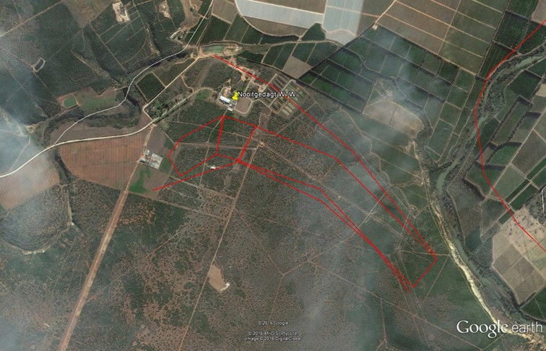
Construct a large balancing dam on the right bank near the Nooitgedagt WTW
Nooitgedagt WTW
Approximate Extent of Mudstone (T-Qg)
250 m
Approximate Extent of Proposed Dam

Slide 8
Next Steps
Preliminary environmental investigation showed no “fatal flaws” for either option.
Meet with respective land owners for both dam sites.
Meet with Scheepersvlakte 98 Citrus Development Trust regarding their request for the temporary abstracting from Scheepersvlakte Dam.
Do detailed geotechnical study to assess suitability of both short-listed dam sites.
Do topographical site survey of both short-listed dam sites in support of preliminary design and costing to be done.

Slide 9
9.4 WUE assessment - Fish and Sundays catchments

Slide 10
Short-listed WUE Interventions
Lining of earth canals in the GFRWUA
Improved measuring and monitoring
Clearing of reeds along the Great Fish River
Reduced operational releases at Elandsdrift Weir
Rehabilitation of Darlington Dam

Slide 11
Preliminary Recommendations
Concrete lining of canals:
The lining of the 500 km of earth canals in the GFRWUA (Intervention 1) is not recommended to be considered further, as the URV for this intervention is too high.
Clearing of vegetation along canals is recommended.
The lining of prioritised “hot spot” high-loss canal sections may be a more feasible option as this will potentially lead to large volumes of water savings at a lower cost. It is recommended that this sub-intervention be investigated in more detail. A pilot test case may be useful to ascertain actual costs and to test this sub-option.

Slide 12
Preliminary Recommendations
Improved measuring and monitoring:
The recommendations made for improved measuring and monitoring (Intervention 2) should be considered by the GFRWUA, LSRWUA and the DWS.
Although the potential water savings are not easily quantifiable at present, this intervention will lead to improved management of the system and improved compliance to water allocations and water requests made.
Notes:
Installing real-time monitoring at existing DWS off-take measuring points to get real-time data to WUA without 6 – 8 week delay.
Install more measuring devices along the Great Fish River and main irrigation canals.
Measure flows at tail-end of canals to provide a comprehensive measure of total water use and return flows.

Slide 13
Preliminary Recommendations
Removal of reeds:
The removal of reeds along the Great Fish River (Intervention 3) not be considered further.
Estimated potential water savings are very low in comparison to the other interventions.
Removal of reeds may lead to unintended environmental consequences.

Slide 14
Preliminary Recommendations
Operational releases:
A reduction in operational releases made at Elandsdrift and De Mistkraal weirs (Intervention 4) should be implemented in a step-wise manner.
The reduction of operational releases at Elandsdrift and De Mistkraal weirs could reduce operational losses in the lower Fish River and result in a potential water saving of a maximum of 33 million m³/a, if the operational loss is halved.
This intervention has a low capital cost as it does not involve construction of water supply infrastructure.

Slide 15
Preliminary Recommendations
Refurbishment of Darlington Dam:
The refurbishment of the Darlington Dam (Intervention 5) is currently being evaluated by the DWS. The refurbishment of Darlington Dam could result in water savings in the lower Sundays River catchment due to reduced spills at Korhaansdrift Weir.
Additional yield will also be created should additional allocations be made to the NMBM.
This may influence the potential Lower Sundays River Return Flows Scheme

Slide 16
Summary of Potential Savings
Recommended Intervention | Potential Water Savings (million m³/a)
Reduced operational losses at Elandsdrift Weir | Maximum of 33 – will likely be less than this in practise
Clearing of vegetation along GFRWUA earth canals | 4
Lining of “hot spot” priority canal sections in the GFRWUA | Not quantified – needs further investigation
Rehabilitation of Darlington Dam | Could save up to 18 by reducing spills at Korhaansdrift Raising of dam could lead to additional HFY to NMBM of max 10
Estimated total potential savings: | 15 – 30 million m³/a
Notes:
Final recommendations will be made for the reallocation of the potential water savings in the Alternative Reallocation Options sub-report.

Slide 17
12.2 Potential future Orange River water allocations

Slide 18
Potential additional Orange River water allocations
The total water savings which could potentially be reallocated to the NMBM, should all of the final recommended WUE options be successfully implemented, may amount to 18 million m³/a (50 Mℓ/day) – prelim assumption.
This is equivalent to the difference between the average flow and peak flow of the Nooitgedagt Low-Level Scheme Phase 3, i.e. 210 – 160 = 50 Mℓ/day.

Slide 19
Design Water Requirements
This is a preliminary recommendation for a potential reallocation volume to the NMBM, and it is possible that the actual volume that can potentially be reallocated may be lower or higher than these estimates.
It is recommended that a conservative approach be taken for the preliminary sizing of any potential future bulk water supply or storage infrastructure designed as part of this study, which can be refined once the potential savings are better understood.
Notes:
The capacity of the delivery bulk pipeline from Scheepersvlakte Balancing Dam to the Nooitgedagt WTW is 102.2 million m³/a (280 Mℓ/day), and this is a realistic estimate to consider as the upper limit of the potential WUE water savings at this stage. For the transfer of water volumes higher than this capacity, a new pipeline would need to be constructed to the WTW. This pipeline capacity is 25.6 million m³/a (70 Mℓ/day) more than the peak capacity of Phase 3 of the Nooitgedagt Low-Level Scheme.

Slide 20
AWSS Status Report

Slide 21
Presentation Content
Water availability and requirements
Interventions
Scenario planning

Slide 22
Water Availability

Slide 23
Priority classes for different category water users
Category | % of the water requirement to be supplied
 | 1: 100 year (99%) | 1: 50 year (98%) | 1: 10 year (90%) | 1: 5 year (80%)
Irrigation Gamtoos | 30 | 20 | 20 | 30
Irrigation Other | 20 | 20 | 20 | 40
Urban | 50 | 20 | 20 | 10
Losses | 100 | 0 | 0 | 0
Environmental | 100 | 0 | 0 | 0
Algoa Operating Analysis 2017 noted that it is preferable that all irrigators receive the same priority water throughout the AWSS

Slide 24
Groundwater
Summary of potential groundwater yields:
Groundwater intervention | Lower estimate (million m³/a) | Upper estimate (million m³/a) | Assumed yield (million m³/a)
Coega Fault | 6 | 8 | 8
Churchill Dam | 2 | 4 | 3
Moregrove Fault | 0.8 | 1.6 | 1
Bushy Park | 2 | 4 | 4
Jeffreys Arch | 6 | 9 | 7
Van Stadens | 4 | 4 | 4
Gamtoos Valley | 2 | 4 | 3
Kruisrivier | 0.4 | 1 | 0.5
Total | 23.2 | 35.6 | 30.5

Slide 25
Algoa WSS water availability
Change:
Transferred Orange River water: yield increased as completion of the Phase 2 of the Nooitgedagt Low Level Scheme, from 32.9 million m³/a (90 Ml/d) to 50.0 million m³/a (137 Ml/d)

Slide 26
Water supply from the Algoa WSS
Long-term stochastic yields of the Algoa WSS:
Sources of supply | 1 in 50 year yield or existing allocation/use
 | (million m³/a) | (Ml/d)
NMBM older dams | 3.4 | 9.3
Groendal Dam | 6.8 | 18.6
Uitenhage Springs and boreholes | 2.2 | 6.0
Churchill/Impofu dams | 43.0 | 117.8
Kouga/Loerie dams | 85.0 | 232.9
Sundays River GWS transfer | 50.0 | 137
Combined Total Yield | 190.2 | 521.1

Slide 27
Water Use, Requirements and Balance

Slide 28
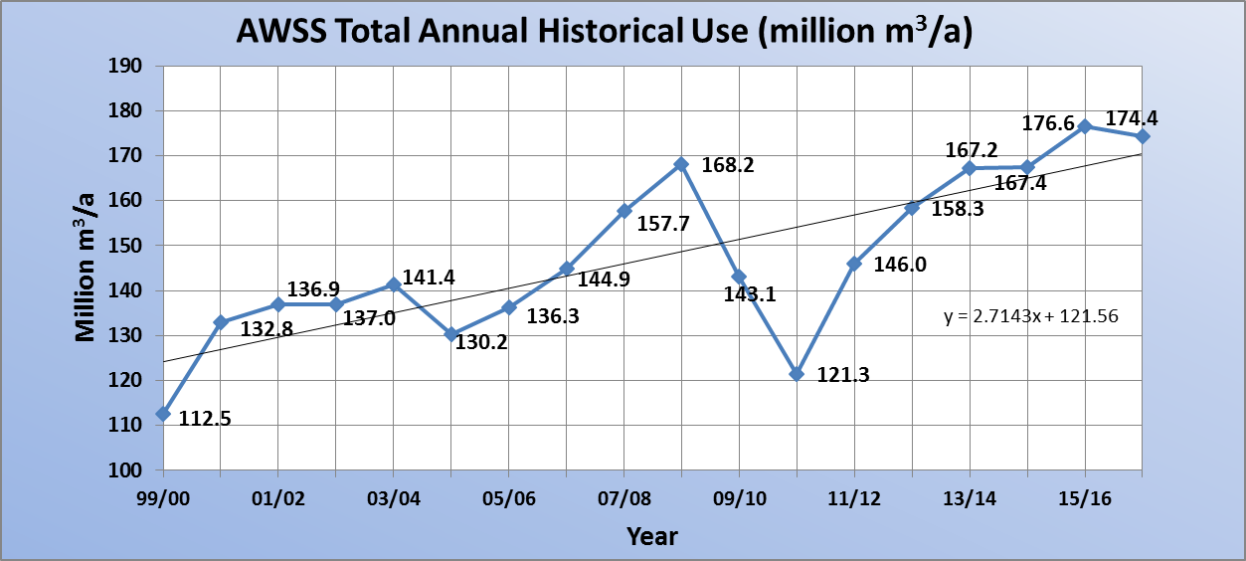
Historical Use from the Algoa WSS
% linear growth pa 3.4%
Trendline growth pa 2.4%
Average linear trendline increase in water use

Slide 29
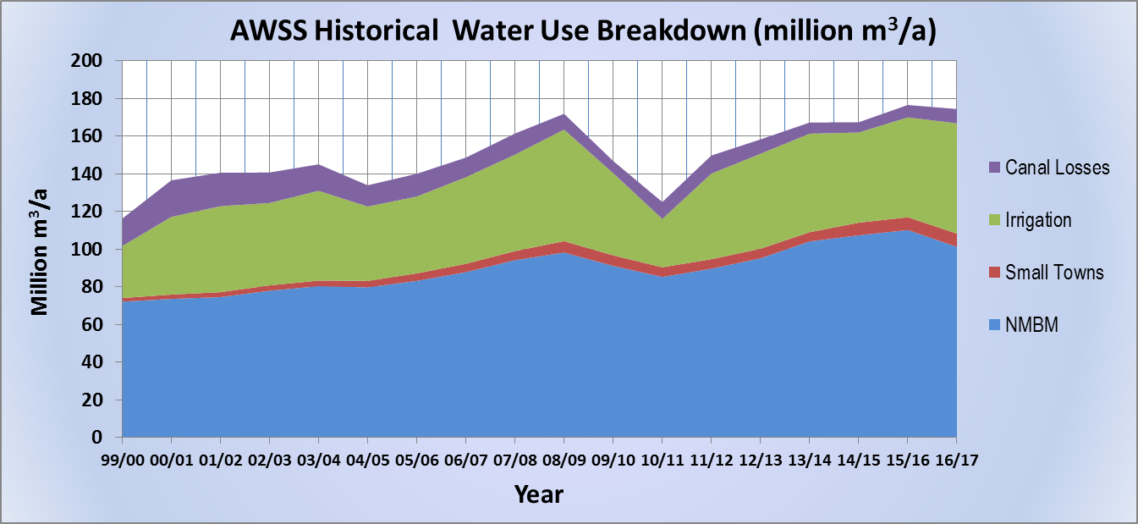
Historical Use from the Algoa WSS
Drought

Slide 30
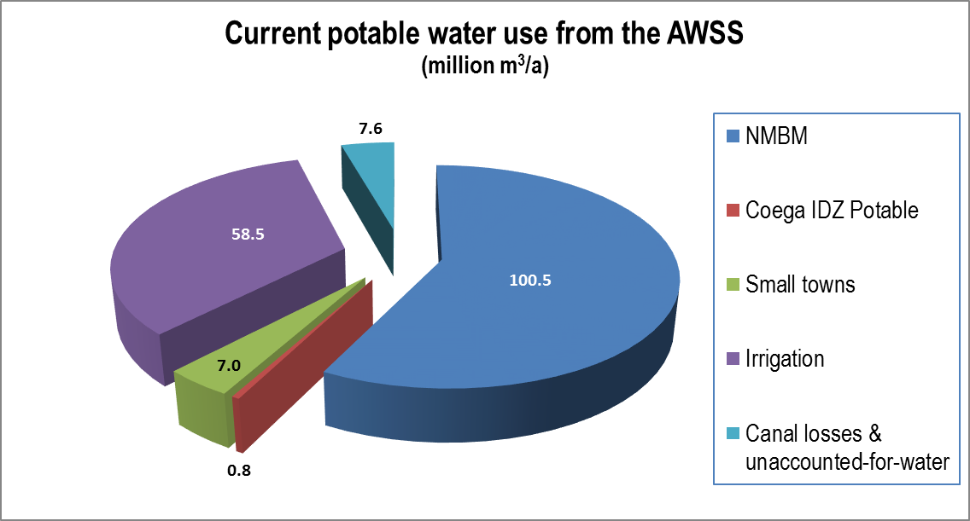
2016/17 Use from the Algoa WSS
TOTAL 174.4 million m³/a

Slide 31
2016/17 Use from the Algoa WSS
million m³/a
NMBM | Kouga LM | Hankie & Patensie | GIB | Groendal irrigation | Impofu Dam irrigation | Canal losses | TOTAL USE
101.26 | 5.85 | 1.2 | 54.1 | 2.4 | 2.0 | 7.6 | 174.4
Allocation of 4.5 million m³/a
GIB irrigation & canal losses preliminary values
Coega IDZ potable use of 0.8 million m³/a estimate

Slide 32
Kouga Dam irrigation water requirements
Change:
GIB allocation increased to 60.188 million m³/a
Direct abstraction from dam of 0.496 million m³/a added
Still to be updated – was updated to 60.05 million m³/a

Slide 33
Water Balance Conclusions
In 2015/16 water use was in excess of availability
This changed in July 2017 with Ph2 of the NLLS becoming operational
2016/17 Water requirements reduced as a result of the drought
(Long-term) water balance surplus of 17.4 million m³/a after implementation of NLLS Ph2
Water use exceeded some allocations, e.g. Kouga LM

Slide 34
Future Water Requirements

Slide 35
Water Requirement Scenarios
8 Water Requirement Scenarios developed - combinations of:
  Low growth of 1% compound growth
  Medium growth of 2.5% / 3.5% linear growth
  Coega IDP domestic & industrial water projections
  Kouga LM as per ‘All Towns’ & Thyspunt NPP estimate
  Implementation of the Reserve
  Climate change
Base year for projections is 2016/17

Slide 36
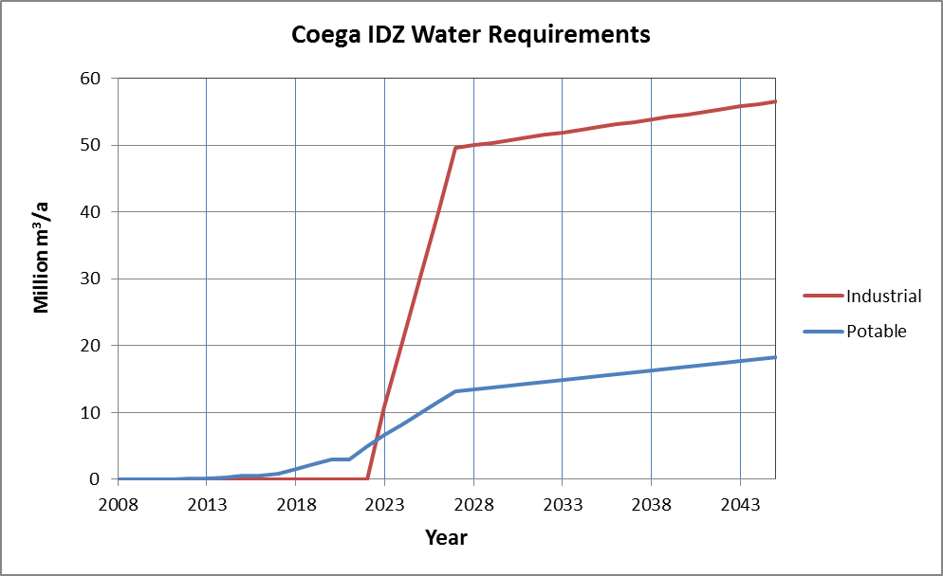
Coega IDZ Water Requirements

Slide 37
Kouga LM
Water use exceeds allocation from AWSS
Growth estimates from All Towns Study
New source needed
Groundwater implementation strongly recommended
Uncertainty regarding development of Thyspunt NPP

Slide 38
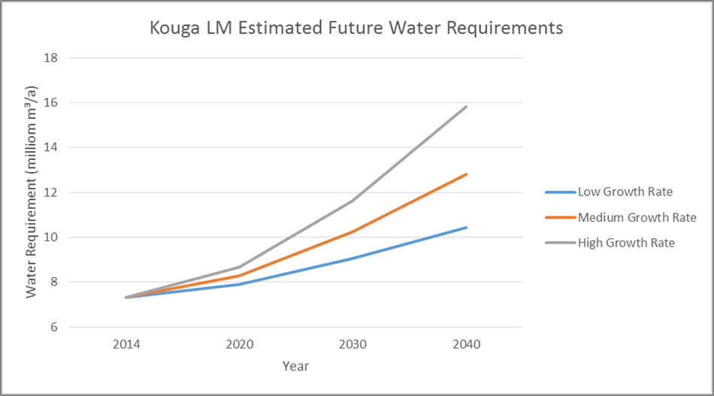
Kouga LM

Slide 39
Interventions

Slide 40
Interventions Considered for Scenario Planning
WC/WDM: 5%, 10% & 15% savings
Nooitgedagt Low Level Scheme, Phase 3 / Phase 3 full use
Effluent treated to industrial and/or potable standards
  Fish Water Flats WWTW Reuse, phased
  Coega WWTW Reuse, phased
Various groundwater schemes
Lower Sundays River return flows
Seawater Desalination: Swartkops sea salt, NMBM (phased) & Thyspunt
Raising of Kouga Dam / Guernakop Dam

Slide 41
Changes to Interventions
Further allocation of Orange River water to NMBM
  NLLS Phase 3 full use included – yield of 18.25 million m³/a (50 Ml/d)
Seawater Desalination
  Swartkops Sea Salt Desalination included (yield = 5.5 million m³/a)

Slide 42
Scenario Planning

Slide 43
Scenarios Developed
Scenario Planning up to 2042
Coega Industrial Water Requirements
Low Growth including Coega Potable: 1% compound growth + Coega potable
High Growth Potable (Reference): 3.5% linear growth + Coega potable
High Growth Potable without WC/WDM: 3.5% linear growth + Coega potable (no efficiency saving from WC/WDM)
Increased supply to Kouga LM: 3.5% linear growth + Coega potable, including increased supply to Kouga LM
High Growth including Coega: 3.5% linear growth + Coega potable and industrial
Worst Case: 3.5% linear growth + Coega potable and industrial, with climate change & implementation of the Reserve

Slide 44
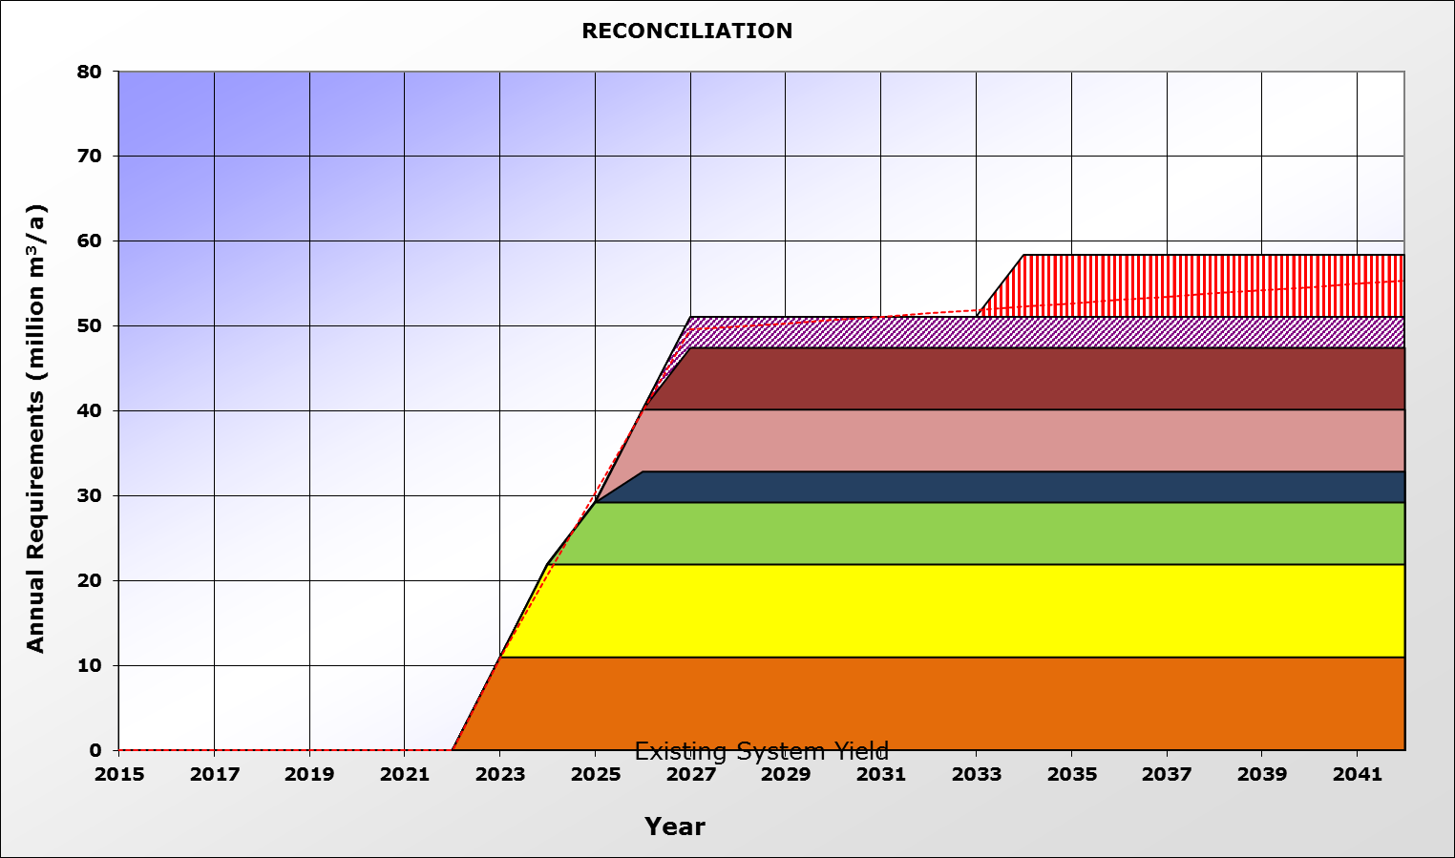
1. Coega Industrial Water Requirements
Coega Industrial water requirements
Coega WWTW Industrial Reuse Ph 4 Ind
Coega WWTW Industrial Reuse Ph 3 ind
Coega WWTW Industrial Reuse Phase 3 dom
Coega WWTW Industrial Reuse Ph 2 Ind
Coega WWTW Industrial Reuse Ph 2 dom
Coega WWTW Industrial Reuse Ph 1 dom
FWF WWTW Industrial Reuse Ph 2
FWF WWTW Industrial Reuse Ph 1

Slide 45
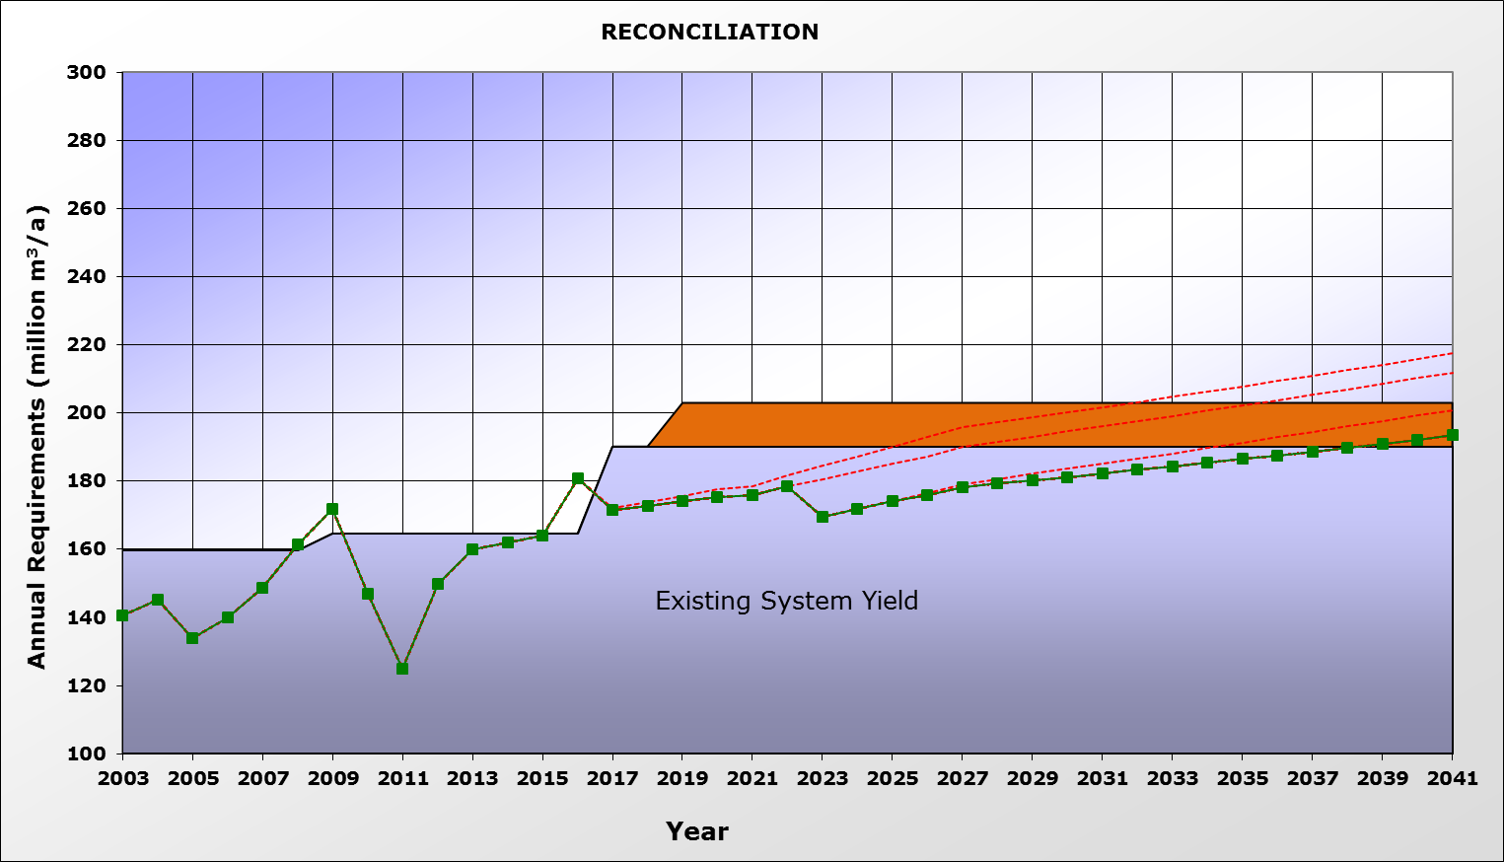
2. Low Growth including Coega Potable
Industrial effluent to Coega – ex-FWF Phase 1
Requirement = 1% compound growth + Coega potable
5% WC/WDM
5% WC/WDM
Nooitgedagt Low Level Scheme Phase 3

Slide 46
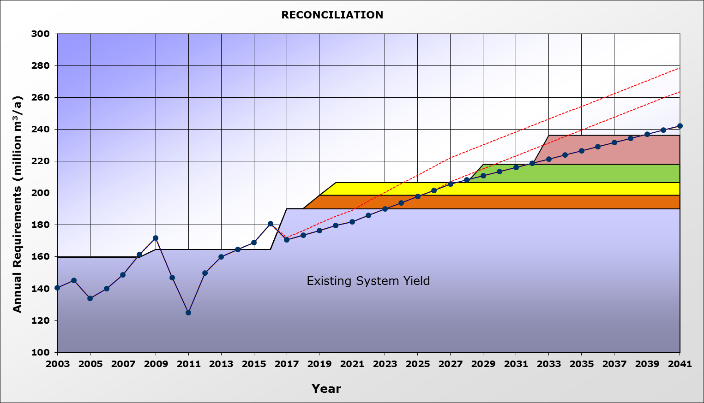
3. High Growth Potable Scenario (Reference)
15% WC/WDM
Requirement = 3.5% linear growth + Coega potable
15% WC/WDM
NLLS Phase 3 Full Use
Lower Sundays Return Flows
Groundwater Coega Fault
Nooitgedagt Low Level Scheme Phase 3

Slide 47
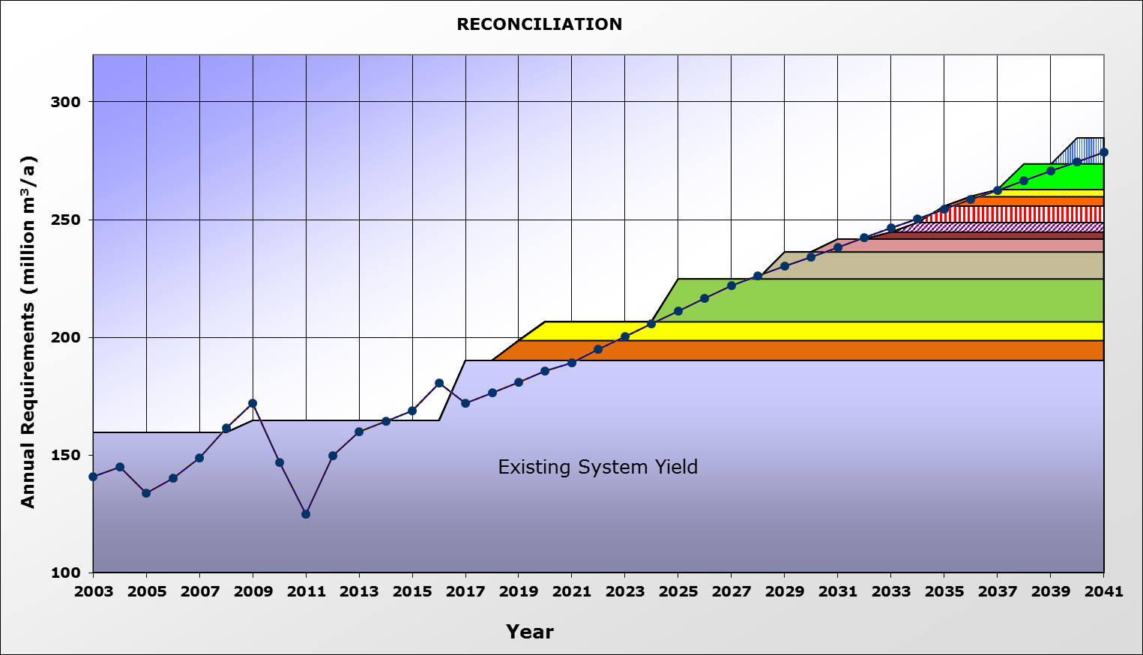
4. High Growth Potable without WC/WDM
Seawater Desal Ph 2
Seawater Desal Ph 1
Requirement = 3.5% linear growth + Coega potable
5 groundwater schemes
Lower Sundays Return Flows
NLLS Phase 3 Full Use
Groundwater Coega Fault
Nooitgedagt Low Level Scheme Phase 3

Slide 48
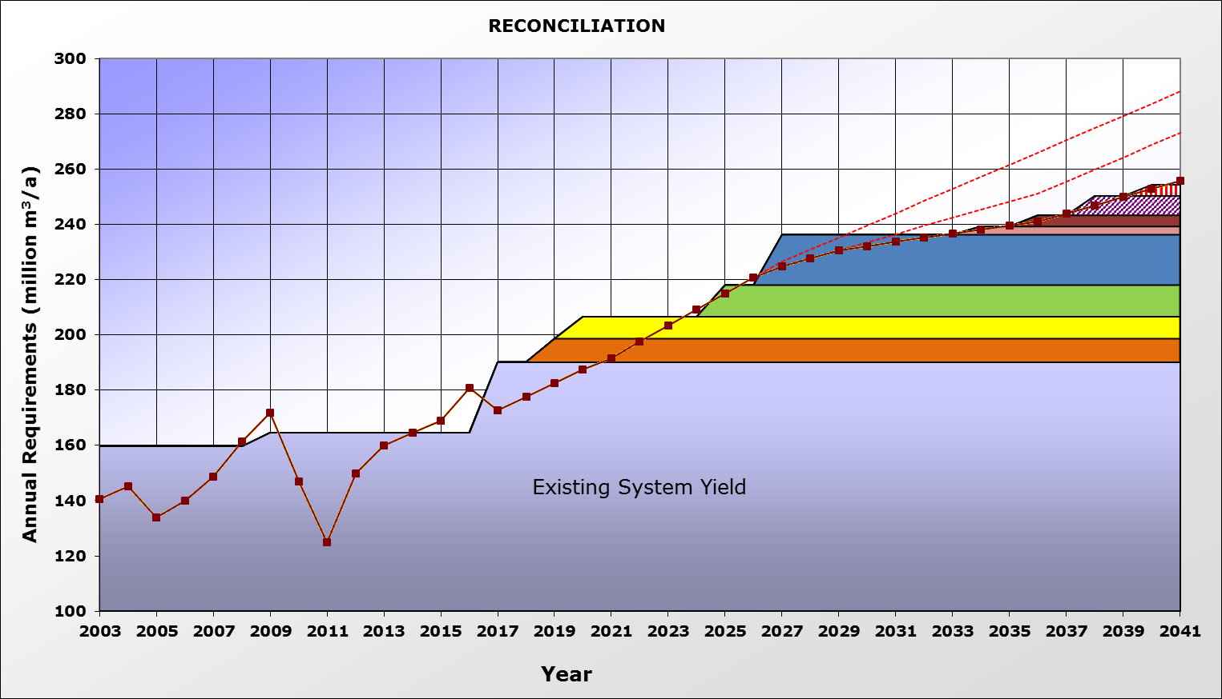
5. High Growth Potable with Kouga LM
15% WC/WDM
Requirement = 3.5% linear growth + Koega additional
15% WC/WDM
Groundwater schemes
NLLS Phase 3 Full Use
Lower Sundays Return Flows
Groundwater Coega Fault
Nooitgedagt Low Level Scheme Phase 3

Slide 49
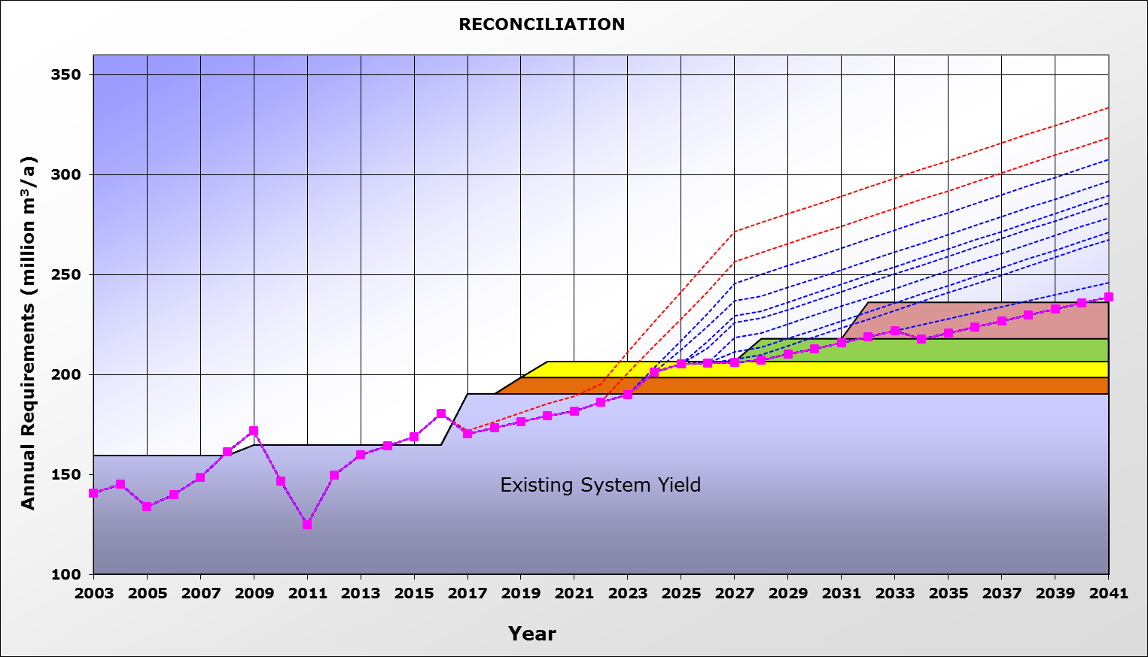
6. High Growth including Coega (pot & ind)
15% WC/WDM
Reuse Coega - FWF WWTW
Reuse Coega – Coega WWTW
Requirement = 3.5% linear growth + Coega pot & ind
15% WC/WDM
NLLS Phase 3 Full Use
Lower Sundays Return Flows
Groundwater Coega Fault
Nooitgedagt Low Level Scheme Phase 3

Slide 50
7. Worst Case Scenario
15% WC/WDM
Reuse Coega – ex FWF WWTW
Reuse Coega – ex Coega WWTW
Requirement = 3.5% linear growth + Coega pot & ind
15% WC/WDM
Seawater Desal Ph 3
Seawater Desal Ph 2
Seawater Desal Ph 1
5 groundwater schemes
NLLS Phase 3 Full Use
Lower Sundays Return Flows
Groundwater Coega Fault
Nooitgedagt Low Level Scheme Phase 3

Slide 51
Scenario Conclusions
Current shortages caused by drought
Effective WC/WDM essential for NMBM & Kouga LM
Complete NLLS Ph3 & remove bottlenecks in delivery
Planning of interventions should proceed due to long implementation lead times & uncertainty in terms of water requirements
Groundwater schemes to be pursued by NMBM & Kouga LM
Thyspunt NPP will have limited impact from water perspective (assuming desalination)

Slide 52
- Thank you -

Slide 53
7 Water Requirement Scenarios
Base Year = 2016/2017
Coega Industrial Water Requirements
Low Growth including Coega: 1% compound growth + Coega potable and industrial
High Growth Potable: 3.5% linear growth + Coega potable (Reference scenario)
High-Growth Potable without WC/WDM: 3.5% linear growth, with no efficiency savings
Increased supply to Kouga LM: 3.5% linear growth plus Kouga LM growth plus Thyspunt NPP

Slide 54
8 Water Requirement Scenarios
Base Year = 2016/2017
High Growth including Coega: 3.5% linear growth + Coega potable and industrial
Worst Case: Same as Reserve Scenario, plus climate change

